Slide 1
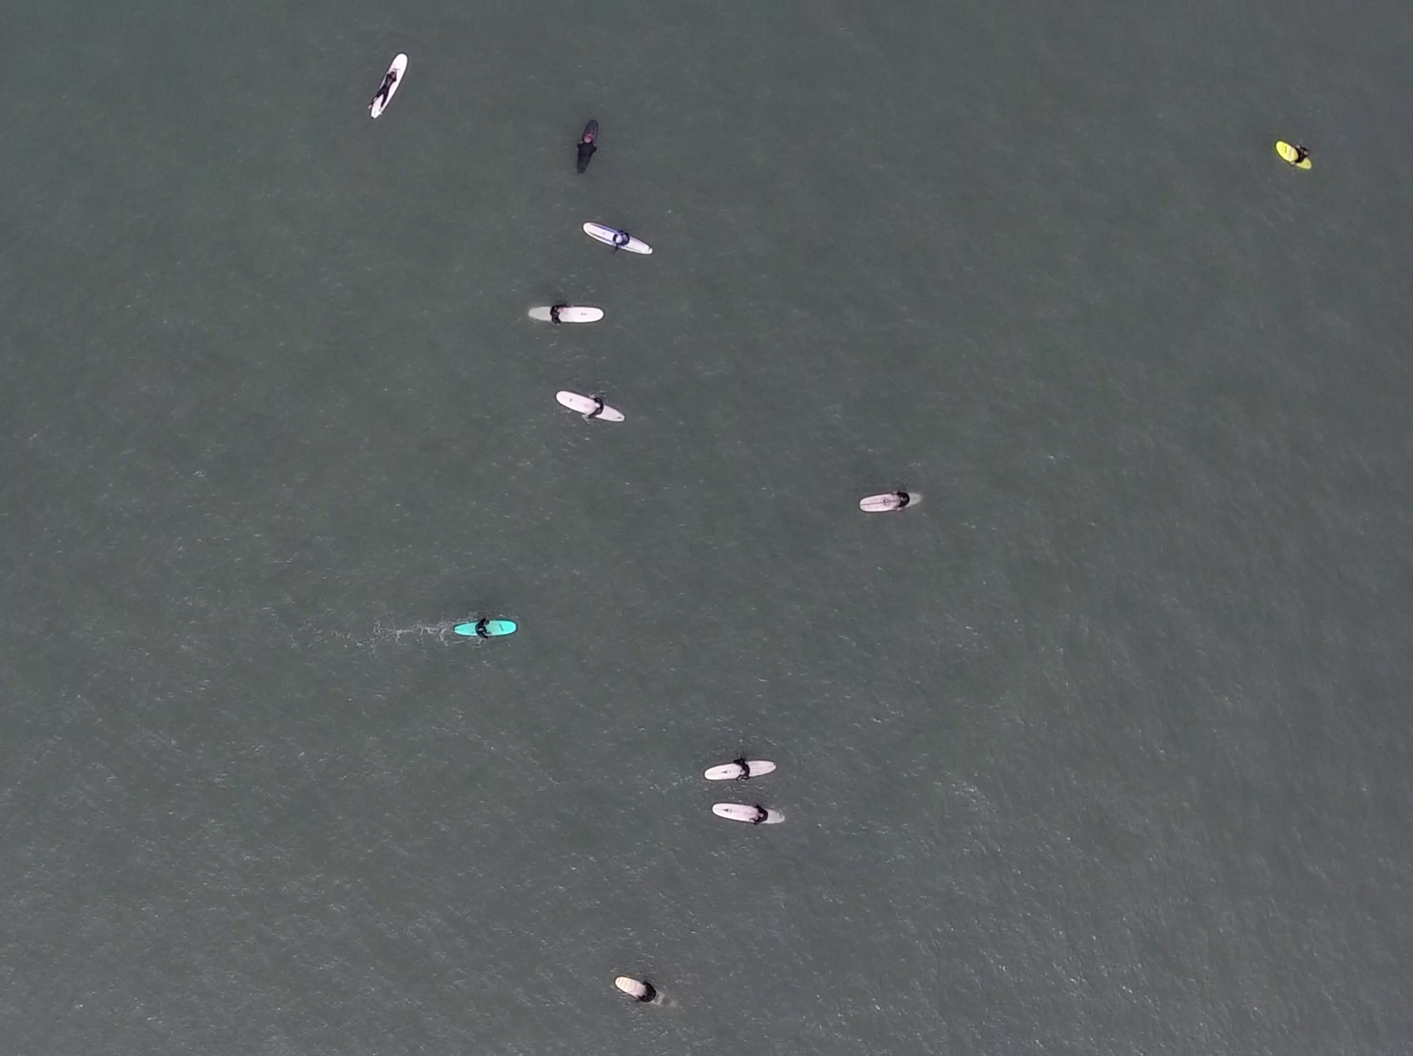
Identifying Humans in Drone Footage from Local Beaches
Photo by Patrick Rex
Echelle Burns – Feb 2020

Slide 2
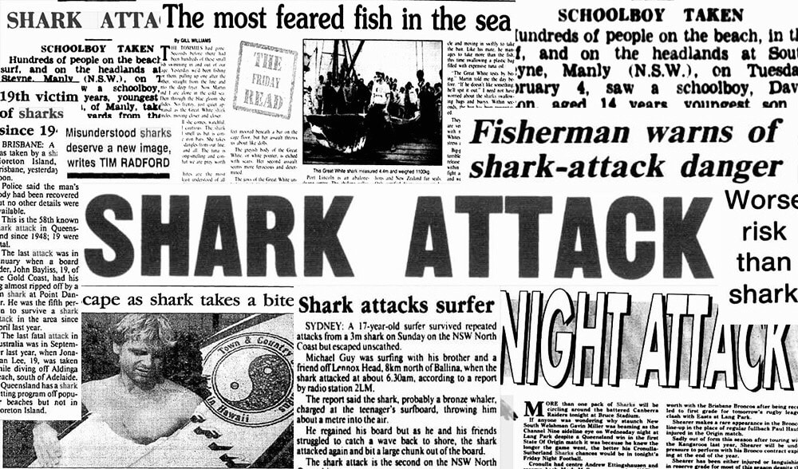


Introduction: The Problem
Shark Attacks are glorified in the media
Shark attacks do not occur as frequently as portrayed by pop culture
No current research on the spatio-temporal overlap between White Sharks (Carcharodon carcharias) and beach recreationalists

Slide 3
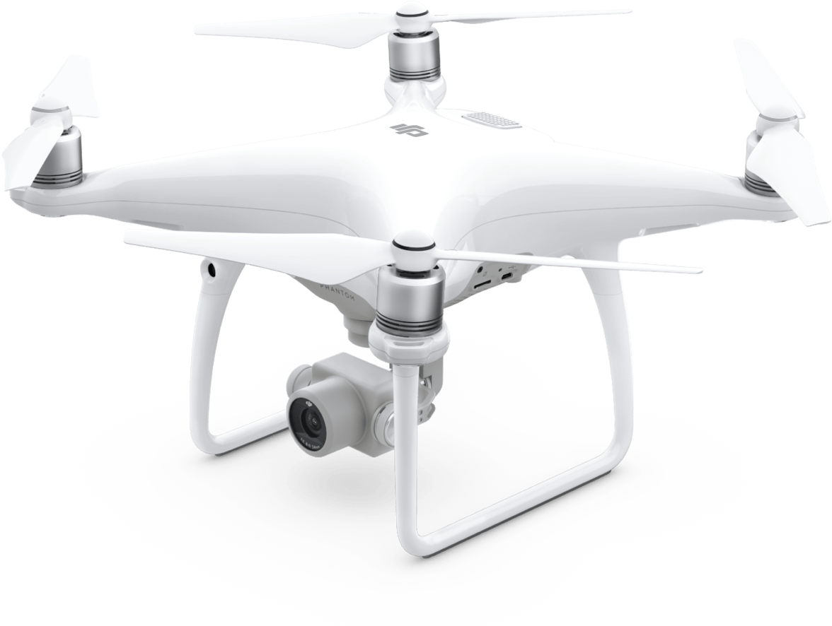
Introduction: The Solution
Drone Technology in Marine Biology:
Increasingly popular
Allows observation of animals without influencing their behavior
Caveats:
Amount of footage increases substantially with each drone flight
Need a fast way to identify whether humans are present in a image

Slide 4
Introduction: Project Objectives
Objectives:
Use a Deep Neural Network to identify how many people are present in each drone still image
Audience:
Researchers with similar problems or who are trying to answer similar research questions
11 humans

Slide 5
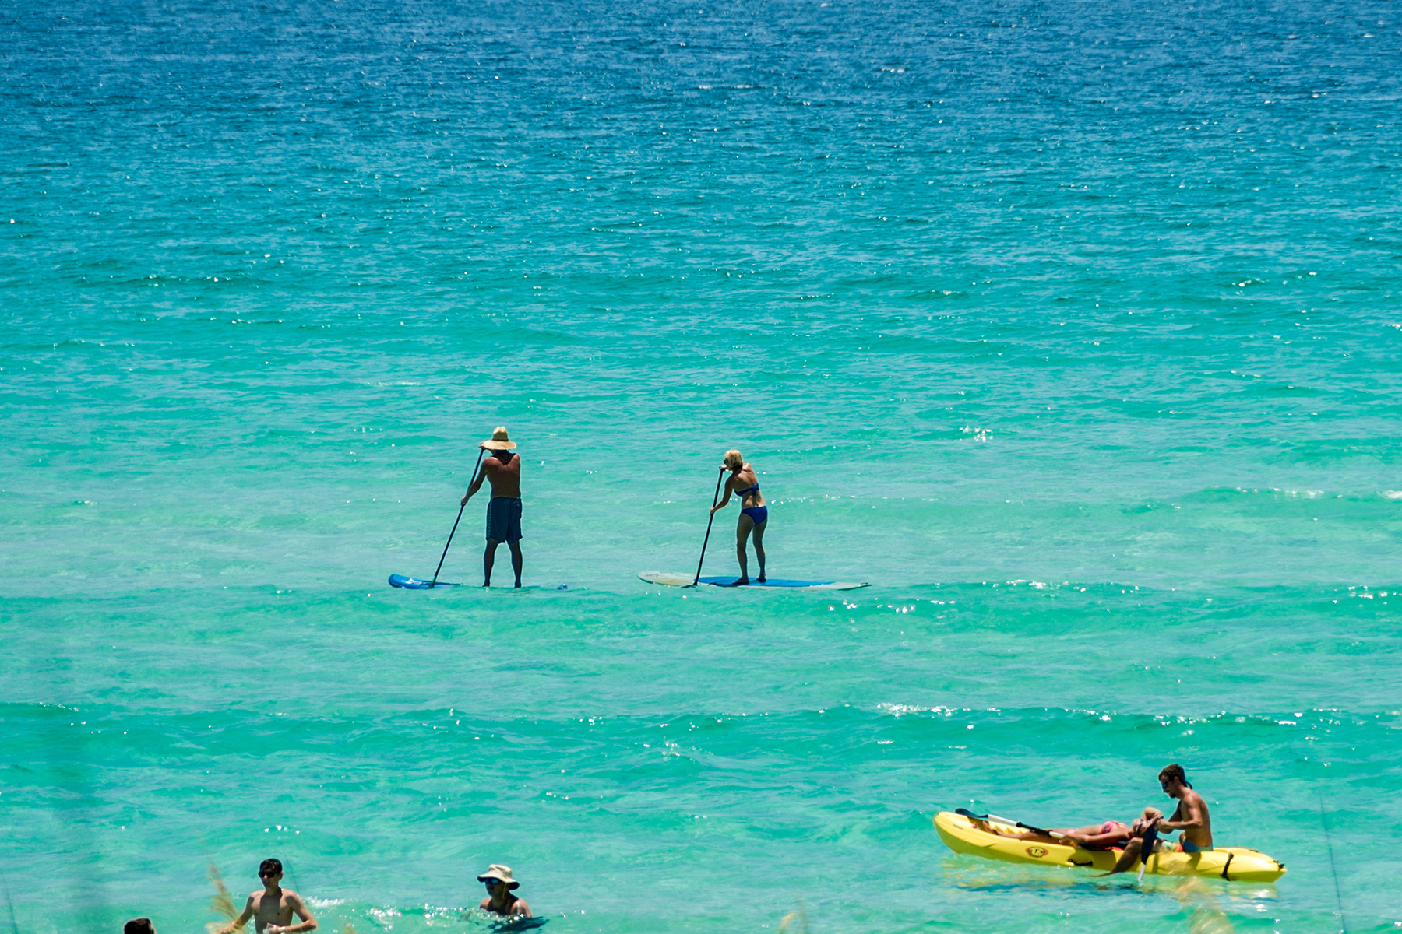
Data Sources
2,465 drone images (3840 x 2160 px) from CSU Long Beach Shark Lab
Surveys along beaches in Southern California
Include footage of:
Beach Recreationalists:
Walking
Wading
Swimming
Paddle boarding
Surfing
Kayaking
White Sharks
Other marine animals
Source: Scenic Sotheby’s International Realty

Slide 6
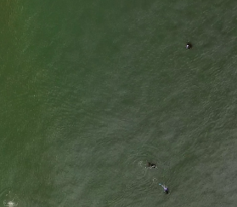
Methods: Image Labeling
Images resized (960 x 540 px) to make labeling easier
Manual labeling by placing dots on locations of humans
Labeled images saved in black and white
Original
Manual Labeling
Labeled Image

Slide 7
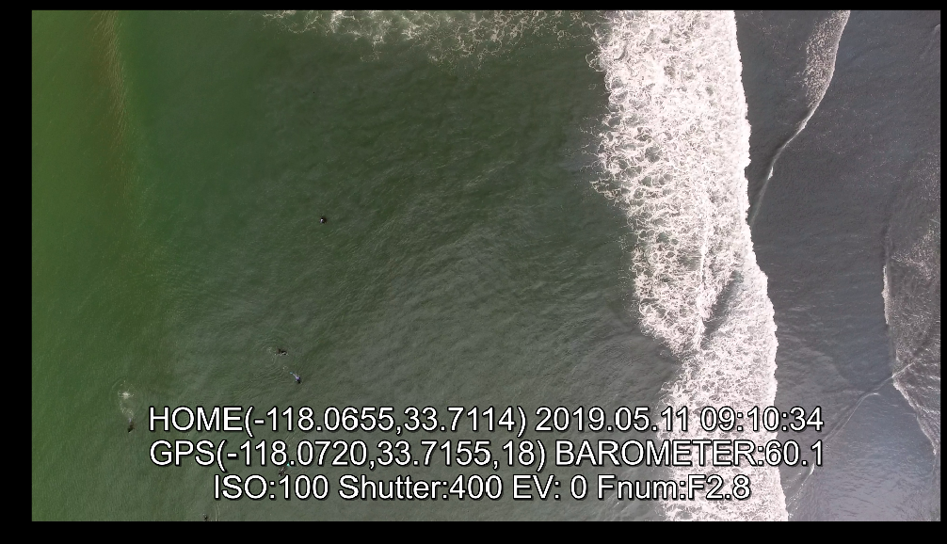

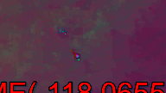
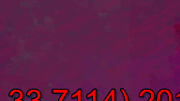
Methods: Image Slicing and Contrast Editing
Resized Images cut into 25 smaller images (192 x 108 px)
Increase model efficiency
Smaller images changed to grayscale/HSV to increase color contrast

Slide 8
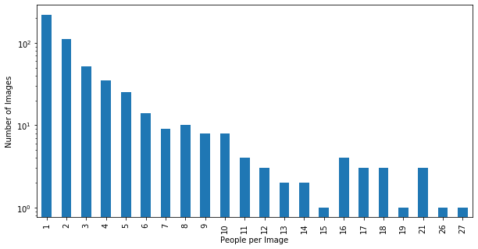
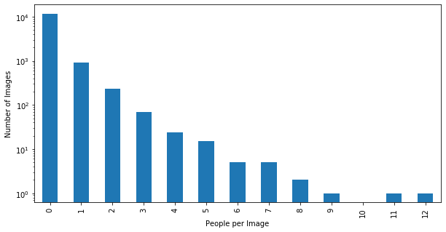
Methods/Results: Exploratory Data Analysis
521 images with humans present
Most with ≤ 7 humans
521 large images yielded 13,025 smaller images
~90% had 0 people
~7% had one person

Slide 9
Methods: Convolutional Neural Networks
Split into training (0.8) and testing data (0.2)
Generator: Grabs groups of images
Batch Size = 10 (default)
Yields: (pixel values, number of people)
Model Selection: Brute Force Method
Tried many models and chose best performing
Best = lowest mean squared error for training and testing
[20,34,
…
123, 345]
[0,0,…
3,5]

Slide 10
Methods: Convolutional Neural Networks
Model Selection: Brute Force Method
Tried many models and chose best performing
General Format:
Convolution Layer
Max Pooling Layer
Flattening Layer
Dense Layer
Dropout Layer
Dense Layer
x4
x2
# of people

Slide 11
Methods: Convolutional Neural Networks
Model Selection: Brute Force Method
Tried many models and chose best performing
Altered:
Presence of a normalization layer
# of kernels in convolutional layers
Size of kernels in convolutional layers
# nodes in dense layers
Using color, grayscale, HSV images
Different HSV channels
Using full images vs splits
Using different activation functions
ReLU, sigmoid, linear, tanh, hard sigmoid, PReLU, swish

Slide 12
Results: Convolutional Neural Networks
Model Selection: Brute Force Method
Best Model:
Split images, HSV channel 2
Normalization Layer
Convolutional Layer
8 kernels, 5x5
Max Pooling: 3x3
Flattening Layer
Dense Layer
512 nodes
Dropout : 0.2
Convolutional Layer
16 kernels, 5x5
Max Pooling: 3x3
Dense Layer
128 nodes
Dropout : 0.2
Convolutional Layer
32 kernels, 2x2
Max Pooling: 2x2
Dense Layer
1 node
(Result)
Convolutional Layer
64 kernels, 2x2
Max Pooling: 2x2

Slide 13
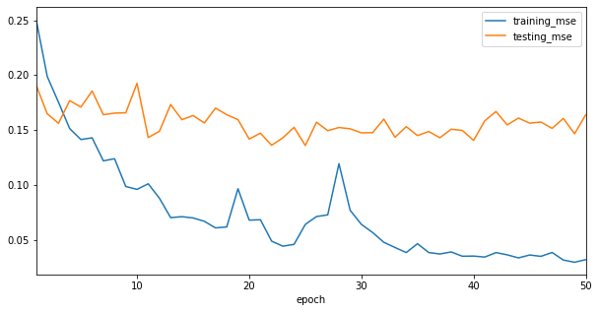
Results: Convolutional Neural Networks
Model Selection: Brute Force Method
Best Model:
Reached training convergence at ~ 35 epochs
Testing mean squared error consistent around 0.17

Slide 14

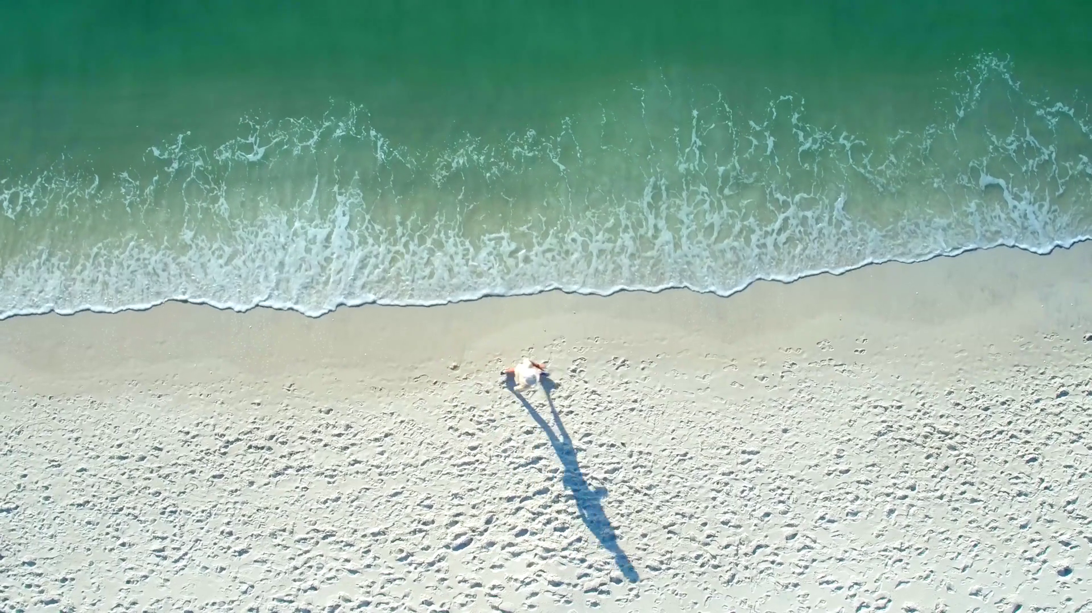
Discussion
Sources of Error
Different recreational activities yield different abstract idea of humans
Solution: Train separate models for separate recreational types
Re-label images focusing on each recreational type independently
Use present model for transfer-learning
Must have many training images with various orientations
≠
Source: Wallheaven
Source: Storyblocks

Slide 15
Discussion
Future Projects
Identify where humans are in images
Result → Center coordinates for human locations
Allows:
Calculation of distance between subjects
Categorization of ‘interaction’ or ‘solitary’ behavior
Examine specific behavioral relationships between subjects

Slide 16
Conclusion
Summary
Model performed well on identifying the number of humans in an image.
Purpose
Less time labeling and sorting images with humans
More time running more sophisticated analyses
Audience
Direct benefits for students in the CSULB Shark Lab
Indirect benefits for researchers who have similar data and are trying to answer similar questions

